Slide 1
Professor Quazi Tarikul Islam
Professor of Medicine
Popular Medical College
Dengue and Special Situations

Slide 2

MANAGEMENT OF DENGUE
ACCORDING TO NATIONAL GUIDELINES FOR CLINICAL MANAGEMENT OF DENGUE SYNDROME -2018

Slide 3
Dengue Case Classification by Severity
This clinical guide uses three categories for case management:
1.Group –A ( mild)
2.Group- B (Moderate)
3. Group – C (Severe)

Slide 4
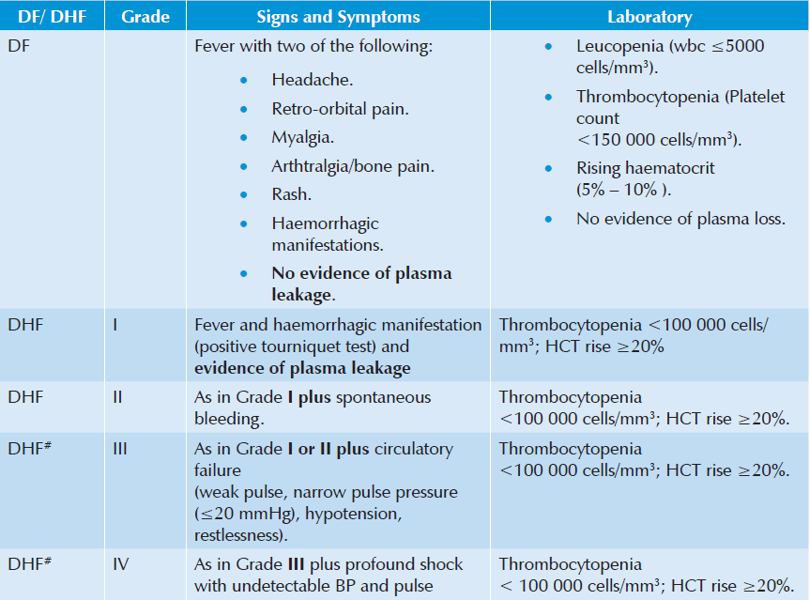
Classification of Dengue previous guideline

Slide 5
Classification of Dengue fever in previous guideline

Slide 6
Patients Group A : Dengue Patient without warning sign.
Patient Group B : Dengue Patient with warning sign.
Patient Group C: Dengue Patient with critical phase of the disease

Slide 7
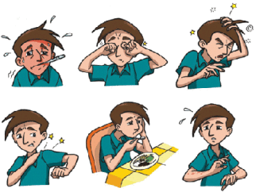
Warning Signs:
No clinical improvement or worsening of the situation just before or during the transition to afebrile phase or as the disease progresses.
Persistent vomiting.
Severe abdominal pain.
Lethargy and/or restlessness, sudden behavioral changes.
Bleeding: Epistaxis, black stool, hematemesis, excessive menstrual bleeding, dark colored urine (hemoglobinuria) or hematuria.
Giddiness.
Pale, cold and clammy hands and feet.
Less/no urine output for 4 – 6 hours
Liver enlargement > 2cm
Hematocrit >20%

Slide 8
Co-existing conditions or risk factors:
Those with co - existing conditions or risk factors may need careful monitoring and hospitalization even without warning signs :
Pregnancy
Infancy
Old age
Obesity
Diabetes mellitus
Hypertension
Heart failure
Renal failure
Chronic hemolytic diseases
Those with certain social circumstances (such as living alone, or living far from a health facility without reliable means of transport)

Slide 9
Patients Group C:
Severe plasma leakage leading to dengue shock and/or fluid accumulation with respiratory distress.
Severe organ impairment (hepatic damage, renal impairment) Myocarditis, cardiomyopathy, encephalopathy or encephalitis.
Severe metabolic abnormalities (metabolic acidosis, severe Hypocalcaemia etc.).

Slide 11

Treatment According to Group A-C

Slide 12
Group – A (May be sent at home)
Group-A criteria:
    Patient who don’t have warning sign
    And
    Who are able-
    -to tolerate adequate amount of ORAL fluids
    -to pass urine at least once in every 6 hours

Slide 13
Group-A (Laboratory test)
Full Blood Count (FBC)
Hematocrit (HCT)

Slide 14
GROUP –A (Advice)
Adequate bed rest
Adequate fluid intake (> 6 glasses for an average-sized adult) - e.g. milk, fruit juice (caution with diabetes patient), oral rehydration solution (ORS) or barley/rice water/coconut water Note: Plain water alone may cause electrolyte imbalance
Take paracetamol (not more than 3 grams per day for adults)
Tepid sponging
Look for mosquito breeding places in and around the home and eliminate them

Slide 15

Group –A (Advice –cont.)
These patients will be advised to avoid:
Acetylsalicylic acid (aspirin), mefenemic acid , ibuprofen or other
NSAIDs
Steroids
Antibiotics

Slide 16
Group –A (Monitoring)
Daily review for disease progression:
- Decreasing WBC
-Defervescence
- Warning signs (until out of critical period)
# Advice for immediate return to hospital if development of any warning signs
# Written advice of management (home care card for dengue)

Slide 17
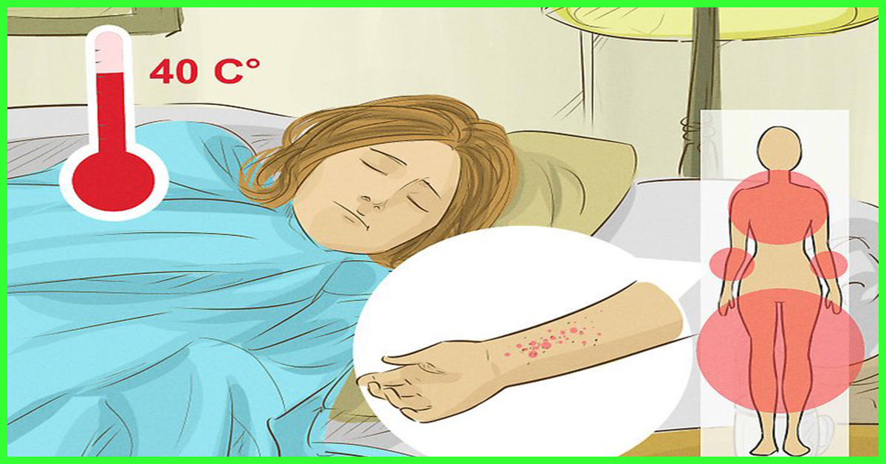
Group-B (Hospital Care)
Group Criteria:
Patient with any of the following features:
# Co-existing conditions such as pregnancy, infancy, old aged, DM
# Social circumstances such as living alone, living far from hospital.
OR
# existing warning signs

Slide 18
Group - B (Laboratory Test)
Full blood count (FBC)
Haematocrit (Hct)

Slide 19
Group B : Cont.
Indications for IV fluid:
when the patient cannot have adequate oral fluid intake or is vomiting.
HCT continues to rise 10%–20% despite oral rehydration.
impending shock/shock.

Slide 20
General principles of Fluid therapy
Crystalloids
1. 0.9% Nacl (isotonic normal saline solution) (0.9%NS) (Preferable)
2. 0.45% half strength normal saline solution (0.45%NS) (For children)
3. 5% dextrose in lactated Ringer's solution (5%DRL)
4. 5% dextrose in acetated Ringer's solution (5%DRA)
5. Hartman solution (Preferable)
Colloids
1. Dextran 40
2. Hemaceel
3. Plasma
4. Blood & Blood Components
5. Human Albumin

Slide 21
Group –B ( Fluid consideration)
Isotonic crystalloid solutions should be used throughout the critical period except in the very young infants <6 months of age in whom 0.45% sodium chloride may be used.
Hyper-oncotic colloid solutions (osmolarity of >300 mOsm/l) such as dextran 40 or starch solutions may be used in patients with massive plasma leakage, and those not responding to the minimum volume of crystalloid. Iso-oncotic colloid solutions such as blood and blood component may not be as effective.
A volume of about maintenance +5% dehydration should be given to maintain “just adequate” intravascular volume and circulation.
The duration of intravenous fluid therapy should not exceed 24 to 48 hours for those with shock. However, for those patients who do not have shock, the duration of intravenous fluid therapy may have to be longer but not more than 60 to 72 hours.

Slide 22
Group- B (Fluid Requirement)
The fluid requirement, both oral and intravenous, in critical phase (48 hours) is calculated as M+5% (maintenance + 5% deficit).
5% deficit is calculated as 50 ml/kg up to 50kg.

Slide 23
Calculations for normal maintenance of intravenous fluid Infusion:
Normal maintenance fluid per hour can be calculated on the basis of the following formula* (equivalent to Holliday - Segar formula):
4 ml/kg/hr for first 10 kg body weight + 2 ml/kg/hr for next 10 kg body weight + 1 ml/kg/hr for subsequent kg body weight

Slide 24
Fluid Management of Patients in Group B:
In general, the fluid allowance (oral + IV) is about maintenance (for one day) + 5% deficit (oral and IV fluid together), to be administered over 48 hours.
For example, in a child weighing 20 kg, the deficit of 5% is 50 ml/kg x 20 = 1000 ml. The maintenance is 1500 ml for one day. Hence, the total of M + 5% is 2500 ml. This volume is to be administered over 48 hours in non shock patients.
The rate of IV replacement should be adjusted according to the rate of plasma loss, guided by the clinical condition, vital signs, urine output and hematocrit levels.

Slide 25
The admitted patient (Category B) should be started with recommended fluid at a rate of 1.5ml/kg/hr or 40ml/hr (12 d/min) for adults and should be given for 6 hours.
If patients vital signs is stable, then the escalation of fluid is not needed and the same rate can be maintained for a period of 48 hours.

Slide 26
If patient started with 1.5ml/kg/hr (adult 40ml/hr) for 6 hours doesn’t have stable vital signs and adequate urine output, the fluid should be escalated to 3ml/kg/hr (adult 80ml/hr or 20 drops/min) for another 6 hours. This fluid can be escalated to 5ml/kg/hr (adult 120ml/hr or 30d/min and then up to 7ml/kg/hr or adult 200ml/hr or 50d/min) if every 6 hours doesn’t have stable vital sign or urine output.
Patient should be monitor every 2 hours with special attention to vital signs, urine output, respiratory signs and hematocrit etc. In 6 hours of escalation, if patient become stable regarding clinical parameters, the fluids can be gradually decline from 7 to 5 to 3 to 1.5 (ml/kg /hr) or from stages where he was stable. But the fluids should be main tained always for at least 48 hours

Slide 28
Platelet transfusion :
Platelet transfusion is not recommended for thrombocytopenia (no prophylaxis platelet transfusion). The indication of which may be as follows:
    1. Very severe Thrombocytopenia who need urgent surgery
    2. Clinical judgement of the treating physician
If platelet concentrate is not available fresh whole blood may be transfused as per guidelines given under DHF management

Slide 29
Group C:
Group Criteria, Patient with any of the following features:
Severe plasma leakage with shock or /and fluid accumulation with resp. distress
Severe bleeding
Severe organ impairment
Severe metabolic dysfunction

Slide 30
Group C : Laboratory Test
Full blood count
Hematocrit
Other organ function test as indicated

Slide 31
Group C :The goals of fluid resuscitation:
Improving central and peripheral circulation – i.e. decreasing tachycardia, improving BP and pulse volume, warm and pink extremities, capillary refill time < 2 seconds;
improving end-organ perfusion – i.e. achieving a stable conscious level (more alert or less restless), and
urine output ≥ 0.5 ml/kg/hour or decreasing metabolic acidosis.

Slide 32
Group C:Compensated shock
DSS is hypovolemic shock caused by plasma leakage and characterized by increased systemic vascular resistance, manifested by narrowed pulse pressure (systolic pressure is maintained with increased diastolic pressure, e.g. 100/90 mmHg).
When hypotension is present, one should suspect that severe bleeding, and often concealed gastrointestinal bleeding, may have occurred in addition to the plasma leakage.

Slide 33
Group C:Compensated shock (Cont.)
Most cases of DSS will respond to 10 ml/kg in children or 300–500 ml in adults over one hour or by bolus
It is essential that the rate of IV fluid be reduced as peripheral perfusion improves; but it must be continued for a minimum duration of 24 hours and discontinued by 36 to 48 hours.
Excessive fluids will cause massive effusions due to the increased capillary permeability.

Slide 36
Group-C: Decompensated Shock
Characterized by DSS + profound hypotension
Preferably this group of patient need to mange in ICU setting
Oxygen should be started immediately
The bolus 10-20 ml/kg crystalloids should be given within 15-30 min

Slide 37
Group-C: Decompensated Shock(Cont.)
If the vital signs and HcT improved, the fluid can be reduced from 10 ml/kg/hr to 6ml/kg/hr for 2 hours, then from 6 to 3 ml/kg/hr for 2-4 hrs and then 3 to 1.5 ml/kg/hr for another 2-4 hrs. Fluid should be discontinued after 24-48 hrs
If there is no clinical improvement after bolus crystalloids, check HcT.If the HcT is raising(more than 45%, then the fluid should be changed to colloid at (10-20 ml/kg/hr) and if there is improvement, then changes the fluid to crystalloids and succesfully reduce as stated before. The highest dose of colloid will be 30 ml/kg/24 hour

Slide 38
Group C : Decompensated Shock
If the initial bolus crystalloids fluid does not have improvement in vitals
sign and HcT is reduced, then suspect concealed bleeding and blood transfusion should be started immediately at 10ml/kg whole blood or packed RBC at 5ml/kg.
In case of refractory hypotension, look for ABCS and IV ionotropes with
crystalloids as per requirement is to be continued
In case of acidosis, hyperosmolaror ringers lactate should not be used
HcT measurement every hour is more important than platelet count during management.

Slide 40
When to stop intravenous fluid therapy
Cessation of plasma leakage;
Stable BP, pulse and peripheral perfusion;
Hematocrit decreases in the presence of a good pulse volume;
Apyrexia (without the use of antipyretics) for more than 24–48 hours;
Resolving bowel/abdominal symptoms;
Improving urine output.
Continuing intravenous fluid therapy beyond the 48 hours of the critical phase will put the patient at risk of pulmonary oedema and other complications such as thrombophlebitis

Slide 41
Patients at risk of severe bleeding are those who:
Have profound/prolonged/refractory shock;
Have hypotensive shock and multi-organ failure
Are given non-steroidal anti-inflammatory agents;
Have pre-existing peptic ulcer disease;
Are on anticoagulant therapy;
Have any form of trauma, including intramuscular injection

Slide 42
Glucose control
Hyperglycemia and hypoglycemia may occur in the same patient at different times during the critical phase.
Hyperglycemia is associated with increased morbidity and mortality in critically ill adult and pediatric patients.
Hypoglycemia may cause seizures, mental confusion and unexplained tachycardia.
Most cases of hyperglycemia will resolve with appropriate (isotonic, non-glucose) and adequate fluid resuscitation

Slide 43
Glucose Control –Cont.
If hyperglycemia is persistent, undiagnosed diabetes mellitus or impaired glucose tolerance should be considered and intravenous insulin therapy initiated.
Hypoglycemia should be treated as an emergency with 0.1−0.5 g/kg of glucose, rather than with a glucose-containing resuscitation fluid.

Slide 44
Electrolyte and acid-base imbalances
Hyponatremia(common) --The use of isotonic solutions for resuscitation will prevent and correct this condition.
Hyperkaliemia -- is observed in association with severe metabolic acidosis or acute renal injury. Appropriate volume resuscitation will reverse the metabolic acidosis and the associated hyperkaliemia.
Life-threatening hyperkaliemia, in the setting of acute renal failure should be managed with Resonium A and infusions of calcium gluconate and/or insulin-dextrose.
Renal support therapy may have to be considered.

Slide 45
Electrolyte and acid-base imbalances(cont.)
Hypokalemia -- associated with gastrointestinal fluid losses and the stress-induced hyper cortisol state; It should be corrected with potassium supplements in the parenteral fluids.
Serum calcium levels should be monitored and corrected when large quantities of blood have been transfused

Slide 46
Metabolic acidosis
Compensated metabolic acidosis is an early sign of hypovolemia and shock.
Lactic acidosis due to tissue hypoxia and hypo perfusion is the most common cause of metabolic acidosis in dengue shock.
Correction of shock and adequate fluid replacement will correct the metabolic acidosis. If metabolic acidosis remains uncorrected by this strategy, one should suspect severe bleeding and check the hematocrit. Transfuse fresh whole blood or fresh packed red cells urgently.

Slide 47
Metabolic acidosis(cont.)
Sodium bicarbonate for metabolic acidosis caused by tissue hypoxia is not recommended for pH ≥ 7.10. Bicarbonate therapy is associated with sodium and fluid overload, an increase in lactate and pCO2 and a decrease in serum ionized calcium. A left shift in the oxy– haemoglobin dissociation curve may aggravate the tissue hypoxia.
Hyperchloraemia, caused by the administration of large volumes of 0.9% sodium chloride solution If serum chloride levels increase, use Hartmann’s solution or Ringer’s lactate as crystalloid.

Slide 48
Signs of recovery:
Stable pulse, blood pressure and breathing rate.
Normal temperature.
No evidence of external or internal bleeding.
Return of appetite.
No vomiting, no abdominal pain.
Good urinary output.
Stable hematocrit at baseline level.
Convalescent confluent petechial rash or itching, especially on the extremities

Slide 49
Discharge Criteria
No fever for at least 24 hours without the usage of antipyretic drugs
At least two days have lapsed after recovery from shock
Good general condition with improving appetite
Normal HcT at baseline value or around 38 - 40 % when baseline value is not known
No distress from pleural effusions
No ascites
Platelet count has risen above 50,000 /mm3
No other complications

Slide 50
Fluid Overloaded Patient
Some degree of fluid overload is inevitable in patients with severe plasma leakage. Causes of excessive fluid overload are:
Excessive and/or too rapid intravenous fluids during the critical phase
Incorrect use of hypotonic crystalloid solutions e.g. 0.45% sodium chloride solutions
Inappropriate use of large volumes of intravenous fluids in patients with unrecognized severe bleeding
Inappropriate transfusion of fresh-frozen plasma, platelet concentrates and cryoprecipitate
Prolonged intravenous fluid therapy, i.e., > 48 hours from the start of plasma leakage
Co-morbid conditions such as congenital or ischemic heart disease, heart failure, chronic lung and renal diseases.

Slide 51
Fluid Overloaded Patient (cont.)
Clinical features of fluid overload are:
Rapid breathing
Suprasternal in-drawing and intercostal recession (in children)
Respiratory distress, difficulty in breathing wheeze, crepitations
Large pleural effusions tense ascites, persistent abdominal discomfort/pain/tenderness (this should not be interpreted as warning signs of shock)
Increased jugular venous pressure (JVP)
Pulmonary oedema (cough with pink or frothy sputum, wheezing and crepitations, cyanosis) – this may be mistaken as pulmonary
Hemorrhage
Irreversible shock
Puffy pace & leg oedema

Slide 52
Fluid Overloaded Patient (cont.)
Additional investigations needed are:
Blood gas and lactate analysis
Chest X-ray which shows cardiomegaly, pleural effusion, features of heart failure
ECG to exclude ischaemic changes and arrhythmia
Echocardiogram for assessment of left ventricular function
cardiac enzymes

Slide 53
Fluid Overloaded Patient (cont.)
Management of fluid overload:
Review the total intravenous fluid therapy and clinical course & check
and correct for ABCS.
All hypotonic solutions should be stopped.
Switch from crystalloid to colloid solutions as bolus fluids.
Dextran 40 is effective as 10 ml/kg bolus infusions, but the dose is restricted to 30 ml/kg/day because of its renal effects.

Slide 54
Fluid Overloaded Patient (cont.)
In the late stage:
Intravenous Furosemide may be administered if the patient has stable vital signs.
If the patient is in shock, together with fluid overload 10 ml/kg/h of colloid (dextran) should be given.
When the blood pressure is stable, usually within 10 to 30 minutes of
administer IV 1 mg/kg/dose of furosemide and continue with infusion, dextran infusion until completion.

Slide 55
Management of encephalopathy:
Some DF/DHF patients present unusual manifestations with signs and symptoms of central nervous system (CNS) involvement, such as convulsion and/or coma. This has generally been shown to be encephalopathy, not encephalitis, which may be a result of intracranial Hemorrhage or Occlusion associated with DIC or hyponatremia.
Most of the patients with encephalopathy are reported to have hepatic encephalopathy. The principal treatment of encephalopathy is to prevent the increase of intracranial pressure (ICP). Radiological imaging of the brain (CT scan or MRI) is recommended if available to rule out intracranial hemorrhage.

Slide 56
Management of encephalopathy:
Maintain adequate airway oxygenation with oxygen therapy. ICP by the following measures:
Give minimal IV fluid . ideally IV fluid should not be >80% fluid maintenance.
Administer a diuretic if indicated in cases of fluid overload.
Positioning of the patient must be with the head up by 30 degrees.
Early intubation to avoid hypercarbia and to protect the airway.
May consider steroid to reduce ICP. Dexamethasone 0.15 mg/kg/dose IV to be administered every 6–8 hours.

Slide 57
Management of encephalopathy (cont.):
Decrease ammonia production by the following measures:
Give lactulose 5–10 ml every six hours for induction of osmotic
diarrhea.
Local antibiotic gets rid of bowel flora; it is not necessary if systemic
antibiotics are given.

Slide 58
Management of encephalopathy:(cont.)
Maintain Blood sugar
Correct acid-base and electrolyte imbalance
Anticonvulsants should be given for control of seizures: phenobarbital, Dilantin and diazepam IV as indicated.
Transfuse blood, preferably freshly packed red cells, as indicated. Other blood components such as platelets and fresh frozen plasma may not be given because the fluid overload may cause increased ICP.

Slide 59
Management of encephalopathy:(cont.)
Empiric antibiotic therapy may be indicated if there are suspected superimposed bacterial infections.
H2-blockers or proton pump inhibitor may be given to alleviate gastrointestinal bleeding.
Consider plasmapheresis or hemodialysis or renal replacement therapy in cases with clinical deterioration.

Slide 60
Some Important Notes: Pitfalls
Failure to suspect dengue infection in febrile patients with a history of travel to dengue endemic areas within 2 weeks of the onset of illness.
Failures to suspect, identify, and treat other possible diseases such as meningitis or malaria.
Failure to admit patients with signs and symptoms of intravascular volume loss for intravenous hydration.
Failure to administer appropriate fluids to patients with dengue hemorrhagic fever or dengue shock syndrome (moderate and severe) in proper rate.
Failure to refer or transfer potentially critical or critical patients to better facility in time.
Failure to notify public health authorities about suspected cases of dengue infection.

Slide 61
Some Important Notes: special concern
Older patients, particularly those with congestive heart failure, must not be given excessive amounts of intravenous fluids.
Rare cases of vertical dengue transmission have been reported. Dengue should be suspected in pregnant patients with compatible clinical features. The potential for a neonate to be born with signs and symptoms of dengue fever should be anticipated.

Slide 62
Some Important Notes: Don’ts
Do not give aspirin or NSAID for the treatment of fever.
Avoid giving blood transfusion or platelet concentrate unless there is hemorrhage and bleeding, fall in HcT or severe bleeding.
Do not use antibiotics per see for dengue syndromes.
Do not change the infusion rate of fluid rapidly or abruptly i,e, avoid rapidly increasing or rapidly slowing the infusion rate of fluids.
Insertion of nasogastric tube to determine concealed bleeding or to stop bleeding (by cold lavage) is not recommended since it is hazardous.
Avoid IM injections.
Avoid tooth brushing in presence of gum bleeding.

Slide 63
Some Important Notes: Role of steroid
Basis of DHF pathogenesis is hypothesized to be immunologic that is tempting for immunomodulatory drugs for therapy most common of which is steroid.
But it is found that there is no beneficiary role of steroid rather it is harmful and therefore not recommended in the management of DF or DHF .

Slide 64
Some common situations are as follows:
Pregnancy and labor
Elderly patient
Infant patient
Mandatory Surgery
Chronic Liver Disease
Chronic Kidney Disease
Cardiac diseases: Heart Failure, Ischemic Heart Disease, HTN
Diabetes and Dengue
Patient on steroid therapy
Fluid hypersensitivity and anaphylaxis

Slide 65
Management of pregnant patients with DF/DHF close to delivery
Risk of bleeding is at its highest during the period of plasma leakage (critical phase).
Therefore,
  # Unless to save mothers life, avoid Lower uterine segment Caesarean Section (LUCS) or induction of labor during the Critical (plasma leakage) phase.
  # Obstetric procedures (such as amniocentesis or external cephalic version) should be avoided during the illness.
  # If obstetric procedures are to be undertaken,
  Maintain the platelet count above 50,000/mm3 Single donor platelet transfusion is preferred, if available. If platelet transfusion is necessary (aphaeretic platelet)
  If patient goes into spontaneous labor during critical phase take steps to prevent vaginal tears by performing an episiotomy.
  In a case of fetal compromise priority should be given to the mother’s life and decision making should involve the multidisciplinary team.
Counseling the family on the probable outcome is essential.

Slide 66
Dengue in the elderly
Issues in management
About 10% of elderly dengue patients may have no complaints of fever
Higher rate of acute renal failure
The impact of increased co-morbidities.
Ageing-related decline in cardiopulmonary function is another important consideration during fluid replacement and/or resuscitation in dengue illness.
Complications such as congestive heart failure and acute pulmonary oedema may occur.
Frequent assessments and adjustments of the fluid regime are required to avoid or to minimize such complications

Slide 67
Dengue in Chronic Liver Disease
The disease may be decompensated in DHF who was well compensated before Dengue episode.
As DHF involves in hepatic enzyme elevation so critical patient care and regular LFT should be done.
Decompensated CLD should be managed as non-infected patient.
Platelet concentrate & fresh blood maybe required.
Patient should be treated in a hospital where facilities are available.

Slide 68
Dengue in Chronic Kidney Disease(CKD):
Dengue patients with chronic Kidney disease (CKD) have a significantly higher risk of severe dengue and mortality. The outcome correlates with the renal function .
The warning signs of severe dengue are similar to those of uremia in CKD.
Ascites and/or pleural effusion, and signs of plasma leakage in dengue, are not uncommon findings in patients with CKD and fluid retention.

Slide 69
Dengue with Chronic Kidney Disease(CKD):
Challenges in fluid management:
Narrow window of fluid tolerance: Patients with CKD have limited fluid tolerance. Frequent assessments of the hemodynamic state and frequent fluid regime adjustments are mandatory
Urine output: The urine output should not be used as an indicator of the intravascular volume status because patients with CKD can have either low or high urine-output renal failure. Low urine output in CKD contributes to the risk of fluid overload whereas high urine output may aggravate hypovoleamia.
Limited effect of diuretics: Diuretics have a limited effect in CKD, making
patients more susceptible to fluid overload. Dialysis may be required.

Slide 70
Dengue with Chronic Kidney Disease(CKD):cont.
Acid base balance and electrolyte balance:
Patients with CKD are at risk of metabolic acidosis and electrolyte imbalance which will become worse during dengue shock.
If these persist after adequate fluid replacement, dialysis may be considered after hemodynamic stability is achieved .

Slide 71
Dengue with Chronic Kidney Disease (CKD) cont.:
Platelet dysfunction:
Platelet dysfunction, well recognized in CKD together with severe thrombocytopenia ± coagulopathy, predispose the dengue patient to severe bleeding that may be difficult to control.

Slide 72
Dengue with Ischemic Heart Disease:
Aspirin/clopidogrel should be avoided for certain days, until the patient recovers from DHF.
Patients with IHD are more prone to cardiac dysrhythmia, cardiac failure and thrombo-embolism.

Slide 73
Dengue with Hypertension (cont.):
Interpretation of BP:
Patients with chronic hypertension should be considered to be hypotensive when the mean arterial pressure (MAP) declines by 40 mmHg from the baseline, even if it still exceeds 60 mmHg. (For example, if the baseline MAP is 110 mmHg, a MAP reading of 65 mmHg should be considered as significant hypotension.)

Slide 74
Dengue with Hypertension (cont.):
Management issue:
ß-blockers, a common antihypertensive medication, cause bradycardia and
may block the tachycardic response in shock. The heart rate should not be
used as an assessment of perfusion in patients on ß-blockers.
Antihypertensive agents such as calcium channel blockers may cause
tachycardia. Tachycardia in these patients may not indicate hypovolemia.
Knowing the baseline heart rate before the dengue illness is helpful in the
haemodynamic assessment.

Slide 75
Dengue with Hypertension (cont.)
The impact on hypotension:
The continuation of antihypertensive agents during the acute dengue
illness should be evaluated carefully during the plasma leaking phase.
The BP lowering effects of these agents and diuretic therapy may
exacerbate the hypotension and hypo perfusion of intravascular volume depletion.

Slide 76
Diabetes Mellitus and Dengue:
Hyperglycaemia results in osmotic diuresis and worsens intravascular hypovolaemia.
Not correcting the hyperglycaemic state exacerbates the shock state
Hyperglycaemia also puts patients at risk of bacterial infection.
Diabetic ketoacidosis and hyperosmolar hyperglycaemia:
.

Slide 77
Diabetes Mellitus and Dengue(Cont.)
Diabetic Ketoacidosis & Hyperosmolar Hyperglycemia:
Clinical manifestations of diabetic ketoacidosis and hyperosmolar hyperglycaemia (nausea, vomiting and abdominal pain) are similar to the warning signs of severe dengue.
It is not uncommon for dengue shock to be misdiagnosed as diabetic ketoacidosis.

Slide 78
Diabetes Mellitus and Dengue (Cont.)
Hypoglycaemia:
Hypoglycaemia may occur in those patients taking oral hypoglycemic
agents (e.g. long-acting sulphonylurea)
Hypoglycemia could be aggravated by severe hepatitis from dengue.
Some hypoglycemic agents such as metformin may aggravate lactic acidosis, particularly in dengue shock. These agents should be avoided or discontinued during dengue shock and also in those with severe hepatitis.

Slide 79
Diabetes Mellitus and Dengue(Cont.)
Management:
If the patient has gastrointestinal disturbances, blood glucose should be
controlled with intravenous short-acting insulin during the dengue illness.
A validated protocol for insulin dose adjustments to a target glucose level
of < 150 mg/dl (8.3 mmol/L) should be used.
Blood glucose should be monitored every 1–2hours until glucose values
and insulin rates are stable and then every 4 hours thereafter.

Slide 80
Patient on steroid therapy for other condition
In this situation steroid should not be abruptly stopped.
But if necessary, equivalent dosage may be given per IV route during the DS period.

Slide 81
PEARLs (Personal Experience & Resource Listing)
Some PEARLs may help for taking some spot decision, these are:
Leukocyte count has a very important prognostic guide in early phase of dengue infection. Leucopenia < 5000 cells/mm3 indicates that within the next 24 hours the patient will have no fever and he will be entering the critical phase.
What should not be done is as important as what should be done and what should be done should not be overdone.
Hemorrhage during febrile phase signifies DF with unusual hemorrhage and possibly not DHF. But hemorrhage without fever should be critically assessed for DHF.
Multiplying Hb level by 3 is usually found to be around the HcT level.
Sudden pallor signifies internal bleeding.

Slide 82
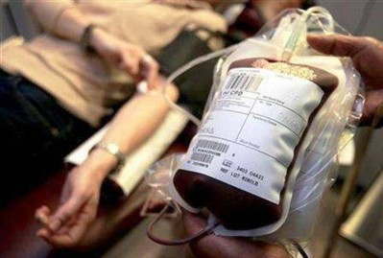
Indications for whole blood
1. Hemoglobin level ≤ 5 gm %
2. Significant bleeding > 10% of total blood volume (TBV). TBV of body is 80 ml/kg.
3. Concealed bleeding manifested by HcT drop and unstable vital signs in spite of adequate volume replacement.
Dose of whole fresh blood:
10 ml/kg/dose at a time.

Slide 83
Indication for platelet concentrate
It has been observed that there is very limited role of platelet transfusion. In most of the situation fresh whole blood transfusion is sufficient.
However it may be required in some special situation. The indication of which may be as follows:
  1. Very severe Thrombocytopania who need urgent surgery
  2. Clinical judgement of the treating physcian
If platelet concentrate is not available fresh whole blood may be
transfused as per guidelines given under DHF management.

Slide 84


